Slide 1








Slide 2

Web Scraping and Data Analysis on Movies in AMAZON PRIME VIDEOS
Team Members:
RAGHVAN
VAMSHI

Slide 3
About me
Background ?
Bachelor of Technology
Bachelor of Statistics(BSC)
Why you want to learn Data Science ?
To know how to use the skills in math, statistics, programming and other related subjects organize large data sets.
To become data scientist
Any work experience
No Work Experience

Slide 4
CONTENTS
Objectives
Libraries Used
Website
Web Scraping
Summary
Exploratory Data Analysis
Conclusion

Slide 5
OBJECTIVES
Our Analysis is basically on finding best rated movies and their releasing year
Exploratory data analysis on our dataset to understand the number of movies released in a year and their ratings

Slide 6
Web Scraping
To Extracting data using web scraping with python, you need to follow these basic
steps:
URL that you want to scrape.
Inspecting the page.
Find the data you want to extract.
Write the code.
Run the code and extract the data.
Store the data in the required format.

Slide 7
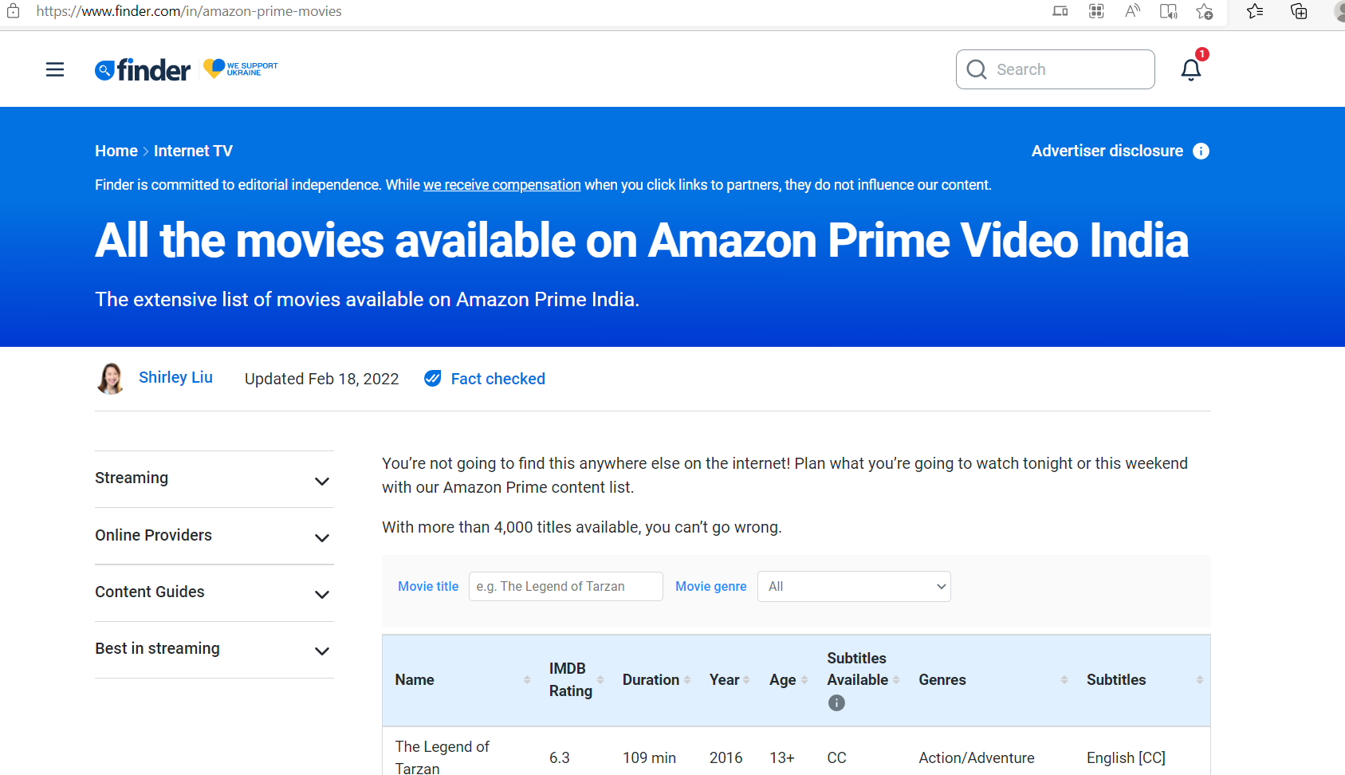
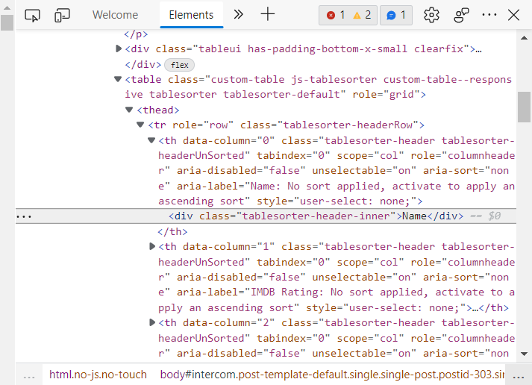
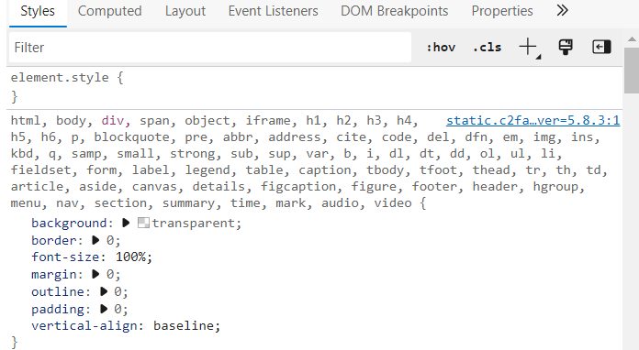
Website
URL: https//www.finder.com/in/amazon-prime-movies

Slide 8


Library Used
requests
BeautifulSoup
pandas
Numpy
seaborn
RegEx
matplotlib

Slide 9
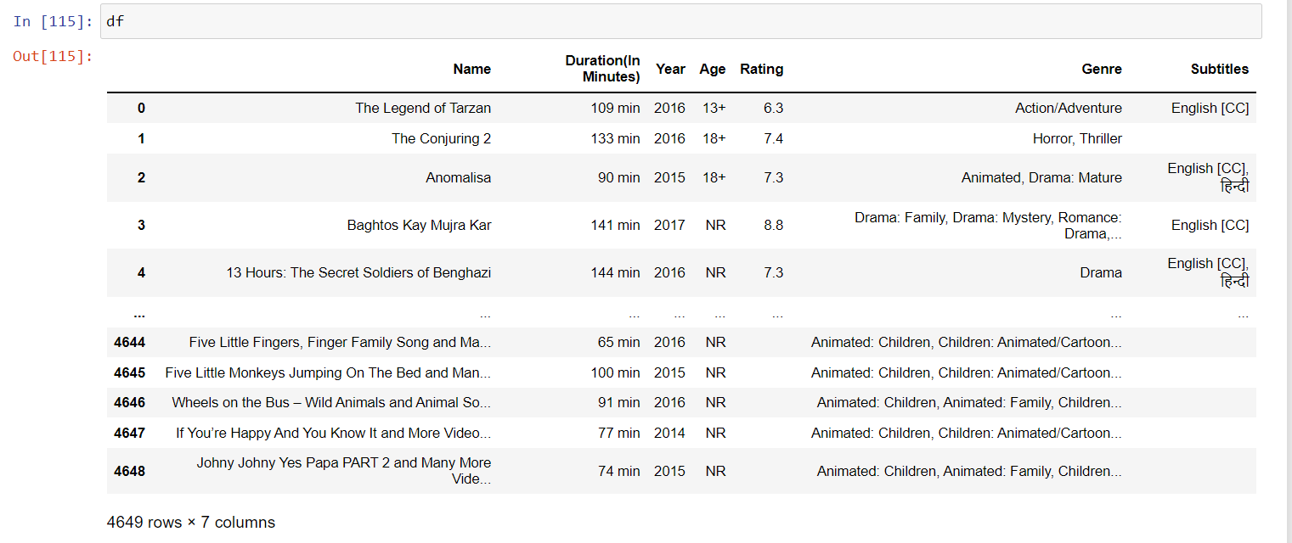
Summary
From the above libraries and code used, we are now able to make a data frame, from which we can use all the information to define the relationship between movies and rating.
Our Dataset contains 4649 unique values and 7 features (4649*7)

Slide 10
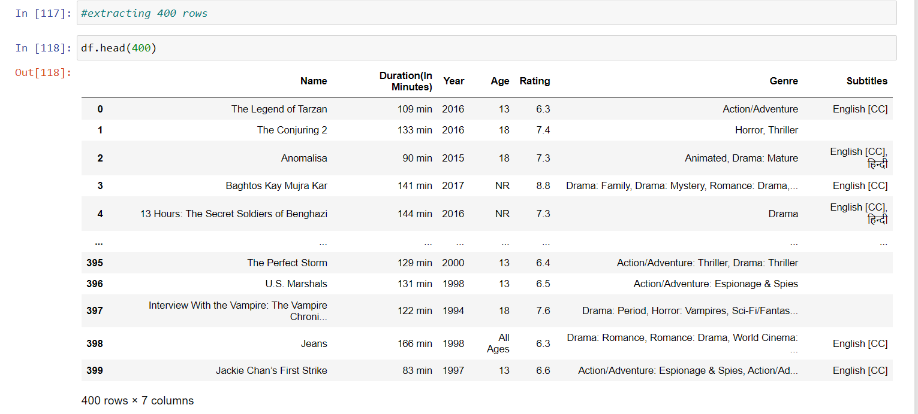
Extracting the DataFrame
We have extracted the DataFrame 4649 to 400 rows.

Slide 11
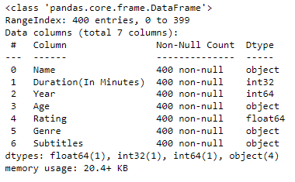
Data cleaning – Removing null values

Slide 12
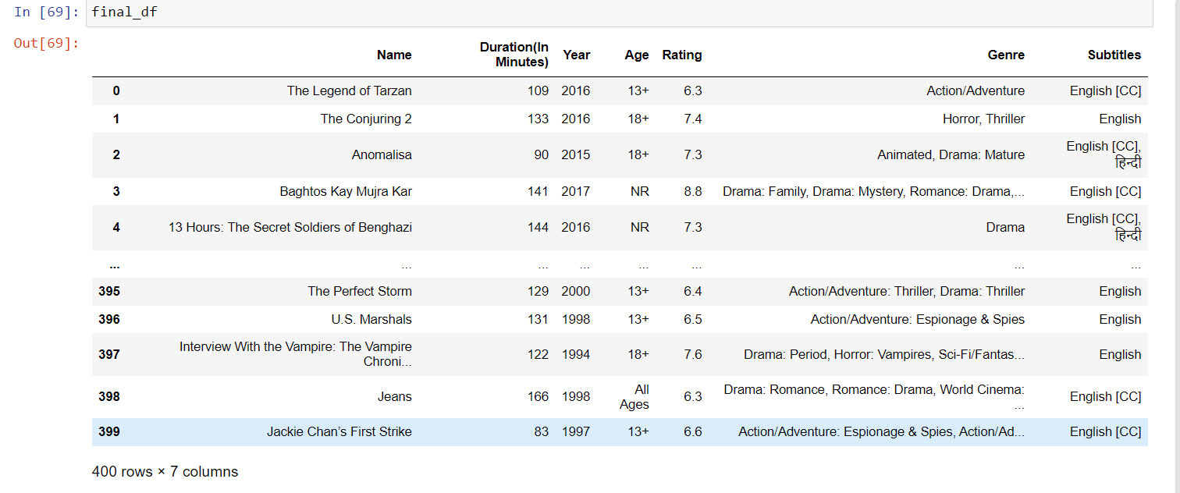
Converting the CSV Format

Slide 13
Exploratory Data Analysis
Exploratory Data Analysis (EDA) is an approach to analyze the data using visual techniques. It is used to discover trends, patterns, or ti check assumptions with the help of statistical summary and graphical representations. For the simplicity of the article, we will use a single dataset.
Types of Exploratory Data Analysis:
Univariate
Bi-Variate
Multi Variate

Slide 14
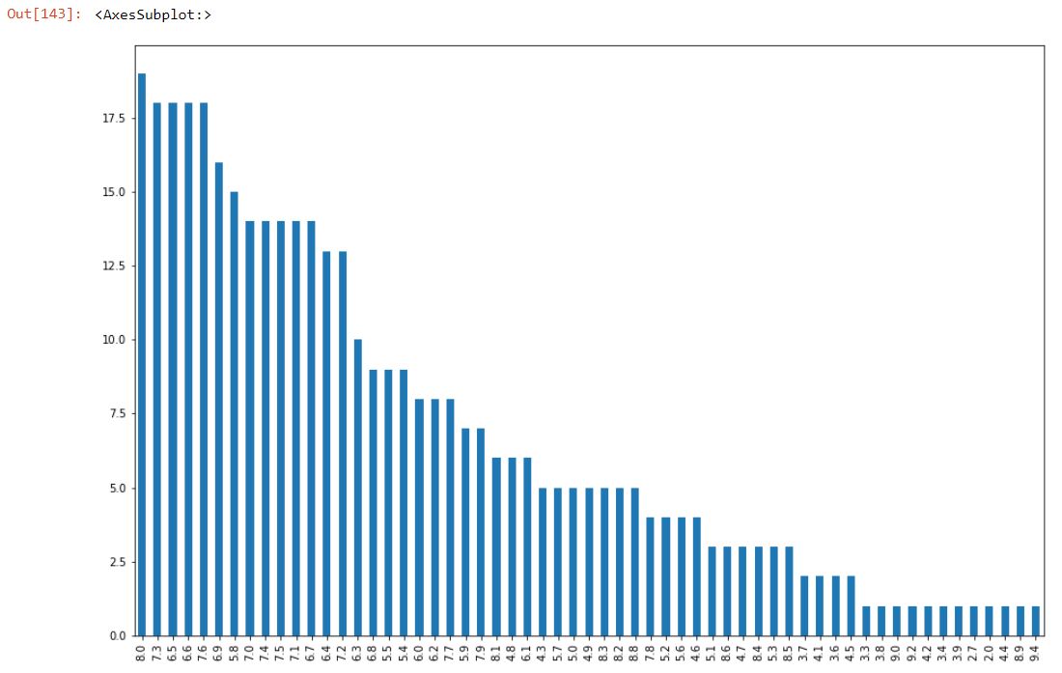
Univariate
Movies and their Ratings

Slide 15
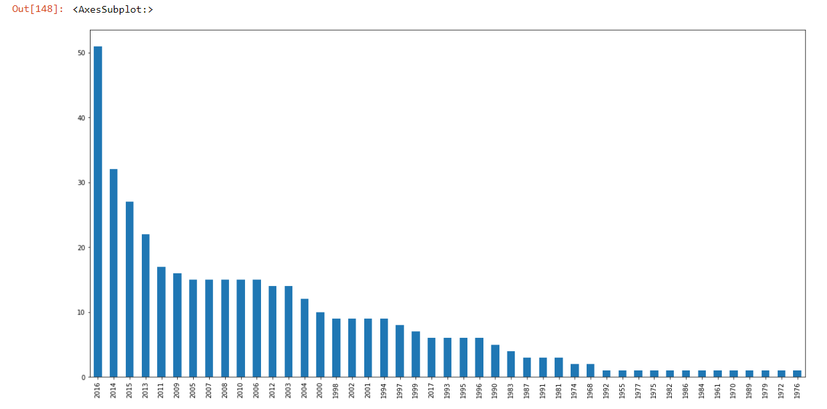
Movies and their Releasing Year

Slide 16
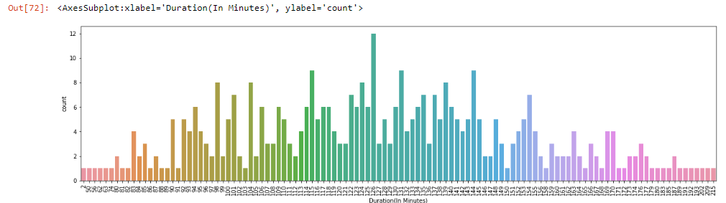
Duration of the movies

Slide 17
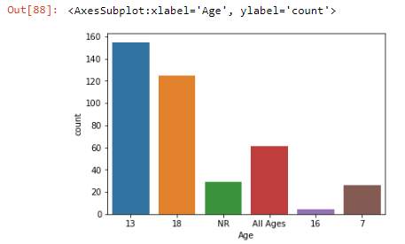
Movies according to Age Limit

Slide 18
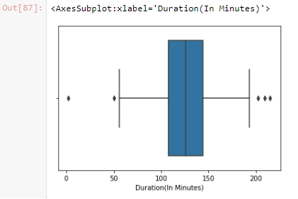
Boxplot

Slide 19
conclusion
From the above observation we have found similar rated movies and the releasing year.
We have concluded movies for various Age Group.

Slide 20

THANK YOU

